Slide 1
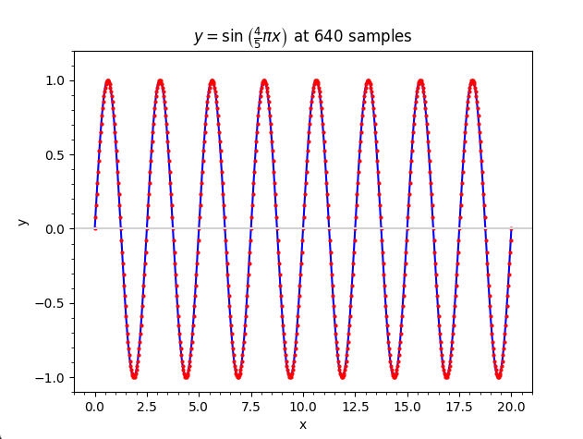
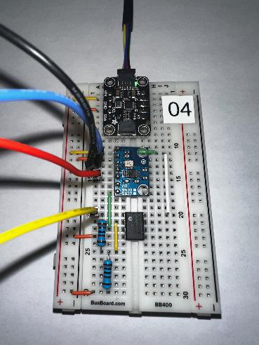
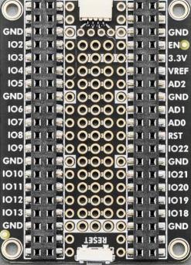
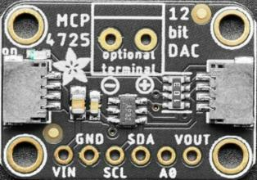
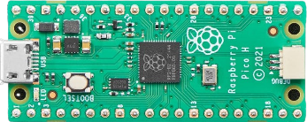
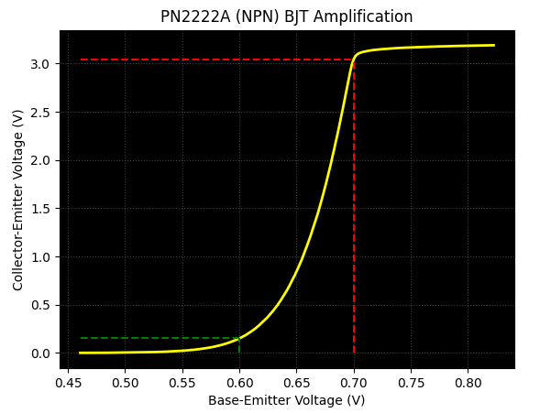

Control System Electronics 101
Using Python and Sensors to Measure Circuits
Topic 04
Differential Equations
Dave Biersach
dbiersach@bnl.gov

Slide 2
Topic 04 – Goals – Part 1 of 3
Leverage Euler’s Method (derived from Fermat's definition of the derivative) to estimate numerical solutions to the differential equation that models the radioactive decay of Carbon-14 and Fluorine-18
Use Euler’s Method to model the simple harmonic motion of a single (unforced, undamped) pendulum
Appreciate the importance of stability in numerical solutions by implementing Cromer’s fix for Euler’s Method that eliminates the possible artificial energy gain in the long-term evolution of an oscillatory system
Numerically estimate the solution to a non-linear differential equation using the Runge-Kutta method

Slide 3
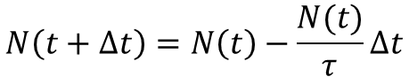
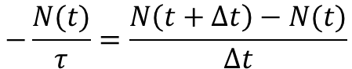
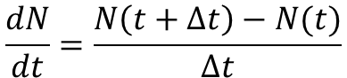
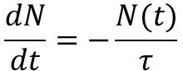
Modelling Nuclear Decay
$N\left(t\right)≡$ number of nuclei at time t
$τ≡$ mean lifetime (half life)
$$\frac{dN}{dt}=−\frac{N(t)}{τ}$$
Fermat's Difference Quotient
$$\frac{dN}{dt}=\frac{N\left(t+Δt\right)−N(t)}{Δt}$$
$$−\frac{N(t)}{τ}=\frac{N\left(t+Δt\right)−N(t)}{Δt}$$
$$N\left(t+Δt\right)=N\left(t\right)−\frac{N(t)}{τ}Δt$$
This is Euler’s Method

Slide 4
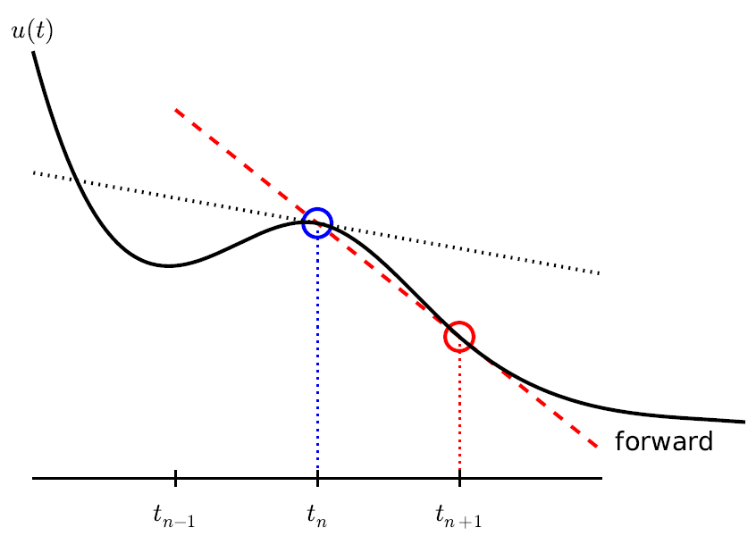
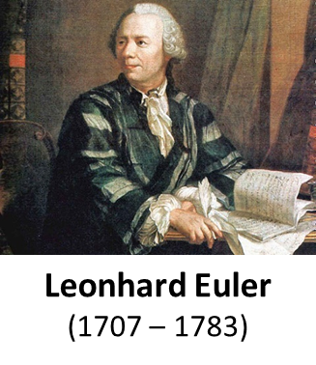
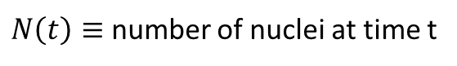
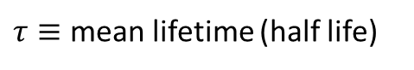
Modelling Nuclear Decay
$N\left(t\right)≡$ number of nuclei at time t
$τ≡$ mean lifetime (half life)
$$N\left(t+Δt\right)=N\left(t\right)−\frac{N(t)}{τ}Δt$$
This is Euler’s Method

Slide 5
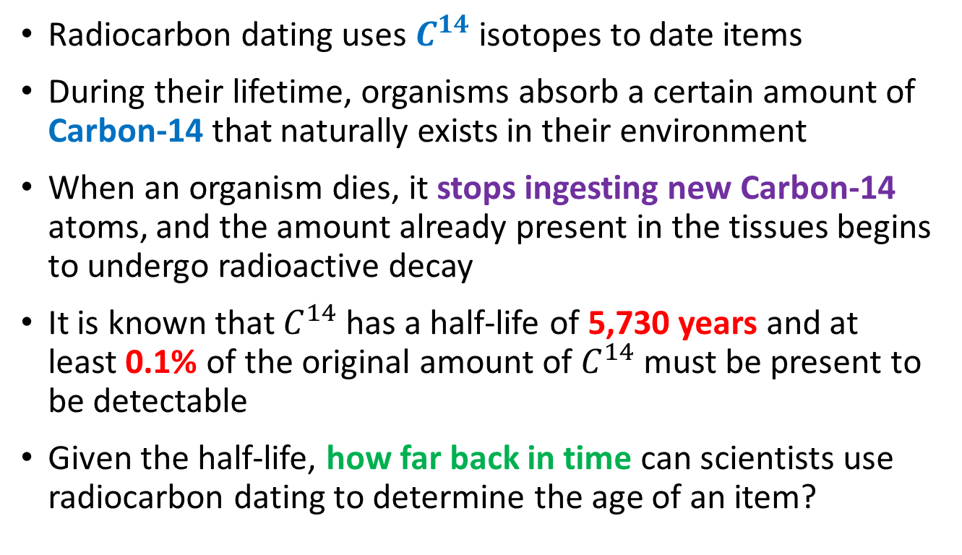
Modelling Carbon-14 Decay
Radiocarbon dating uses $C^{14}$ isotopes to date items
During their lifetime, organisms absorb a certain amount of Carbon-14 that naturally exists in their environment
When an organism dies, it stops ingesting new Carbon-14 atoms, and the amount already present in the tissues begins to undergo radioactive decay
It is known that $C^{14}$ has a half-life of 5,730 years and at least 0.1% of the original amount of $C^{14}$must be present to be detectable
Given the half-life, how far back in time can scientists use radiocarbon dating to determine the age of an item?

Slide 6
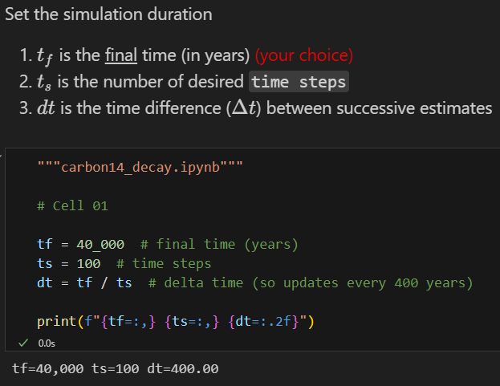

Run carbon14_decay.ipynb – Cell 01
①
②
④
⑥
We will estimate the $C_{14}$ over 100 equal time intervals
③
⑤
⑦
⑧
⑨

Slide 7
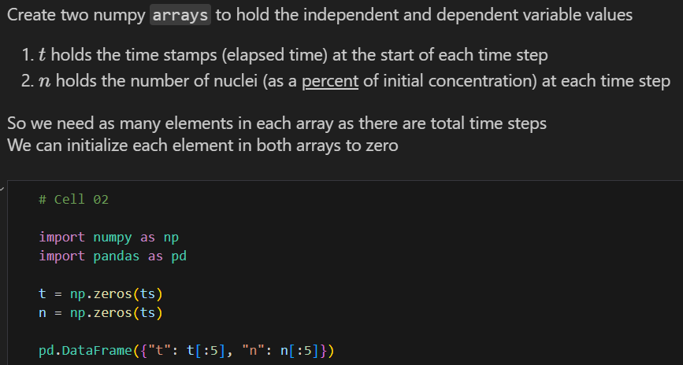

Run carbon14_decay.ipynb – Cell 02
①
②
③

Slide 8
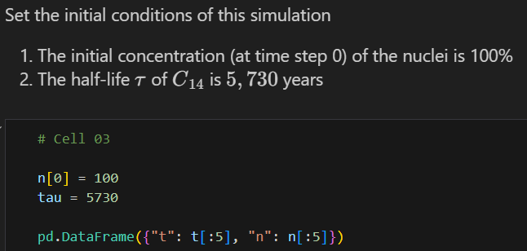

Run carbon14_decay.ipynb – Cell 03
①
②
③

Slide 9
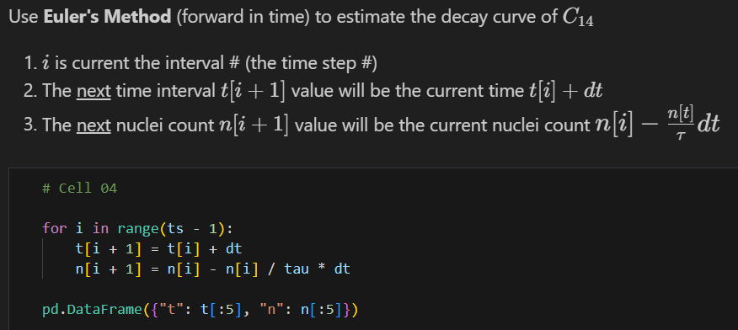
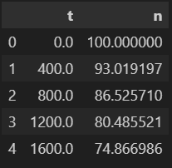
Run carbon14_decay.ipynb – Cell 04
①
②
③
④

Slide 10
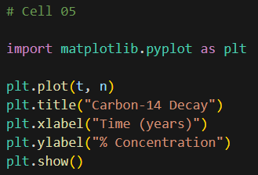
View carbon14_decay.ipynb – Cell 05
①
②
③

Slide 11
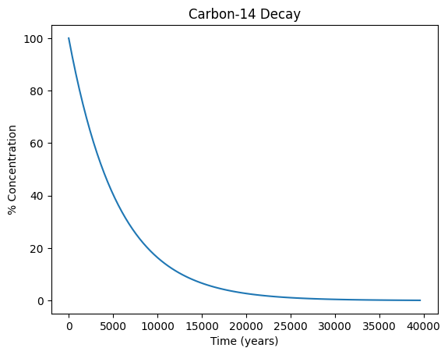
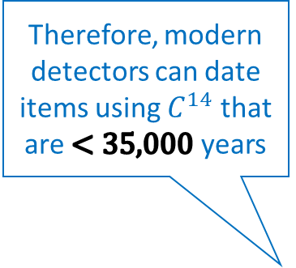
Run carbon14_decay.ipynb – Cell 05
Therefore, modern detectors can date items using $C^{14}$ that are $<35,000$ years
At least 0.1% of the absorbed Carbon-14 must be present to be detectable

Slide 12
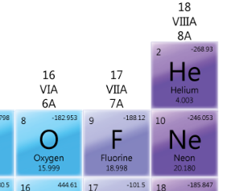
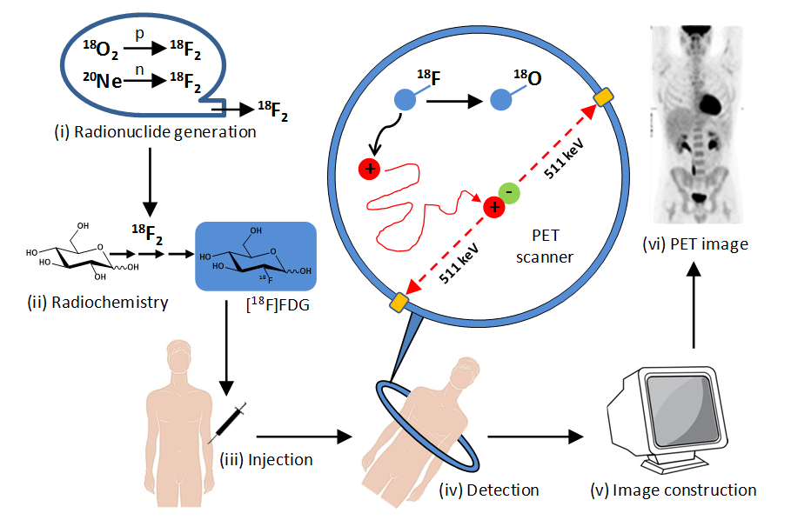
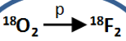

Fluorine-18
At least 5% of the injected Flourine-18 must still be present to be detected

Slide 13
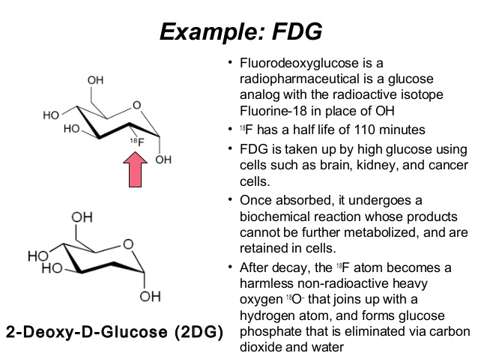
Fluorine-18

Slide 14
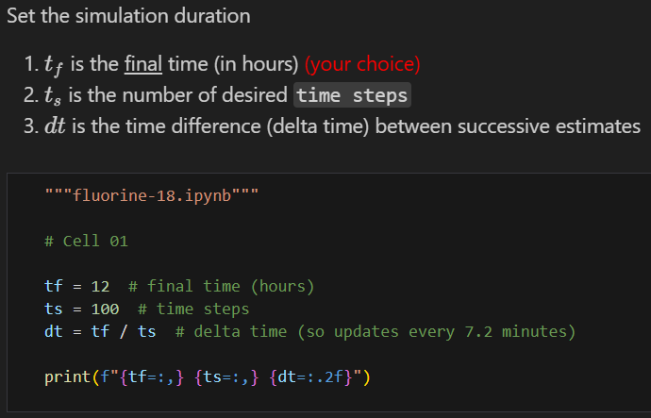


Run fluorine18_decay.ipynb – Cell 01
We will estimate the $F_{18}$ over 100 equal time intervals
①
②
③
④

Slide 15
Run fluorine18_decay.ipynb – Cell 02
①
②
③

Slide 16
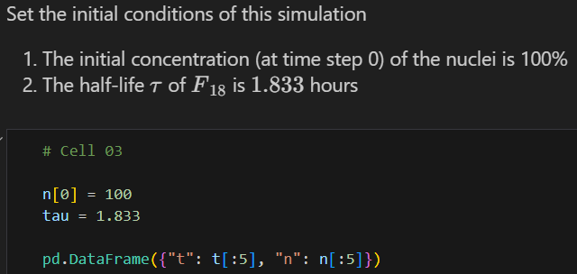
Run fluorine18_decay.ipynb – Cell 03
①
②
③

Slide 17
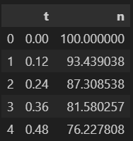
Run fluorine18_decay.ipynb – Cell 04
①
②
③
④

Slide 18
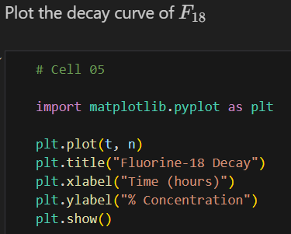
View fluorine18_decay.ipynb – Cell 05
①
②
③

Slide 19
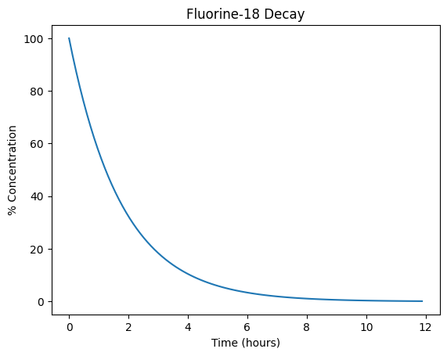
Run fluorine18_decay.ipynb – Cell 05
What two key concepts does this graph suggest?
After 12 hours the ingested Fluorine-18 has decayed enough to not be a lingering threat
Medical staff must get patients into the PET scan within ~5 hours after taking Fluorine-18
At least 5% of the injected Flourine-18 must still be present to be detected

Slide 20
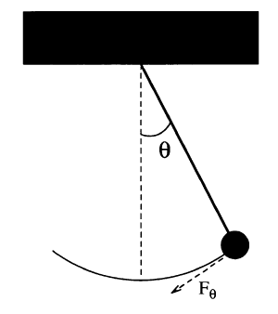
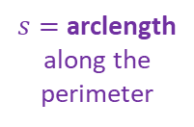
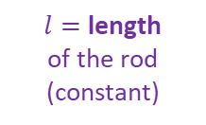
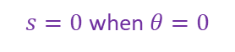
Modelling a Simple Pendulum
Gravity is a restoring force
$$F_{θ}=−mg\sin{θ}$$
$$l$$
$l=$ length
of the rod (constant)
$$ml\frac{d^{2}θ}{dt^{2}}=−mg\sin{θ}$$
$s=$ arclength along the perimeter
But Euler’s Method works only on first order ODEs! ☹
$$\frac{d^{2}θ}{dt^{2}}=−\frac{g}{l}\sin{θ}$$
$s=0$ when $θ=0$
$$s=lθ$$
$$F=ma$$
$$\frac{dω}{dt}=−\frac{g}{l}\sin{θ}$$
Take 2nd derivative of both sides with respect to time
We can break the 2nd order ODE into two linked first-order ODEs and use Euler’s method on each
$$F=m\frac{d^{2}s}{dt^{2}}$$
$$\frac{dθ}{dt}=ω$$
$$\frac{d^{2}s}{dt^{2}}=l\frac{d^{2}θ}{dt^{2}}$$
$$F_{θ}=ml\frac{d^{2}θ}{dt^{2}}$$

Slide 21
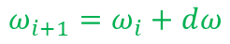
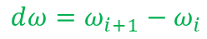
Modelling a Simple Pendulum
$$ⅆω=ω_{i+1}−ω_{i}$$
$$ω_{i+1}=ω_{i}+ⅆω$$
$$\frac{dω}{dt}=−\frac{g}{l}\sin{θ}$$
$$ω_{i+1}=ω_{i}−\frac{g}{l}\sin{θ_{i}}Δt$$
$$l$$
$$\frac{dθ}{dt}=ω$$
$$θ_{i+1}=θ_{i}+ω_{i}Δt$$
This is Euler’s Method
in time…

Slide 22
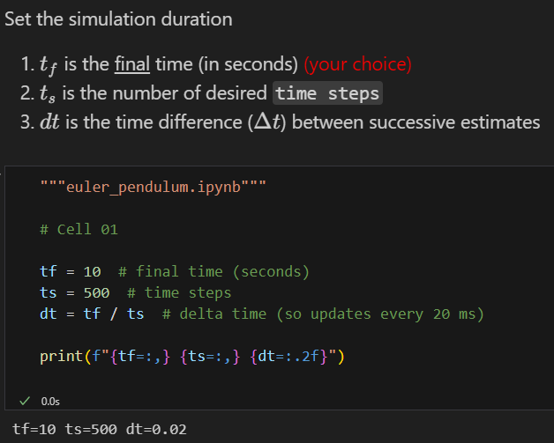
Run euler_pendulum.ipynb – Cell 01
①
②
③
④
⑤

Slide 23
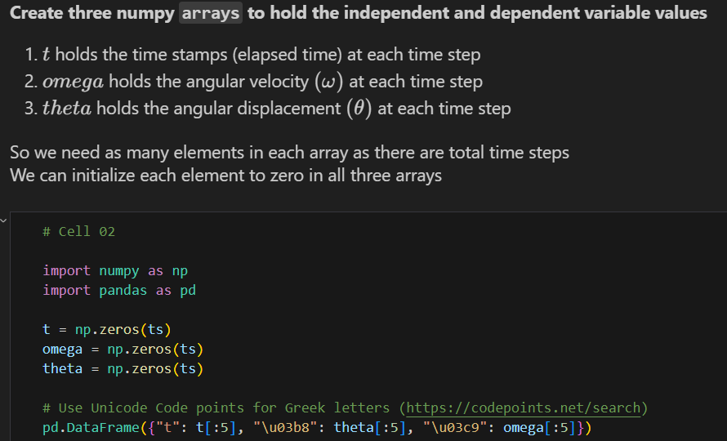

Run euler_pendulum.ipynb – Cell 02
①
②
③
④

Slide 24
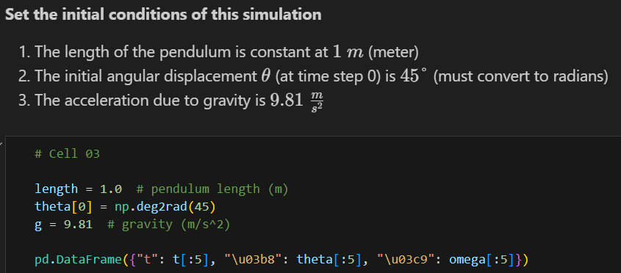
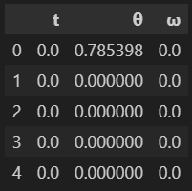

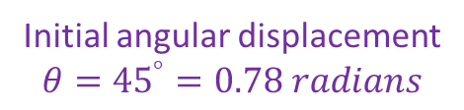
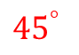
Run euler_pendulum.ipynb – Cell 03
①
②
1m
③
$${45}^{°}$$
④
Initial angular displacement
$$θ={45}^{°}=0.78 radians$$

Slide 25
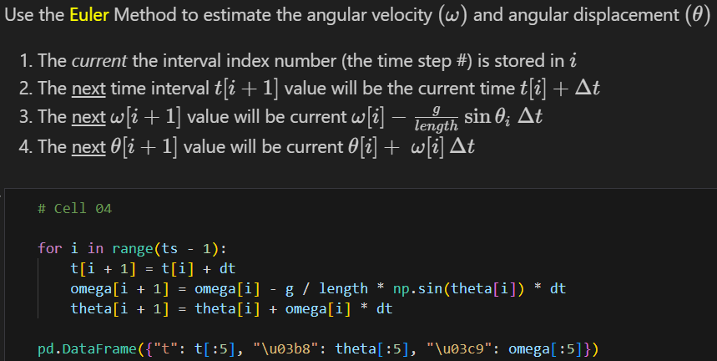
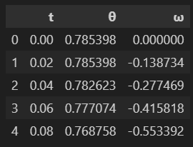
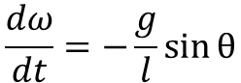
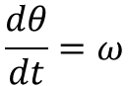
Run euler_pendulum.ipynb – Cell 04
①
②
③
④
$$\frac{dω}{dt}=−\frac{g}{l}\sin{θ}$$
$$\frac{dθ}{dt}=ω$$
①
②
③
④
⑤

Slide 26
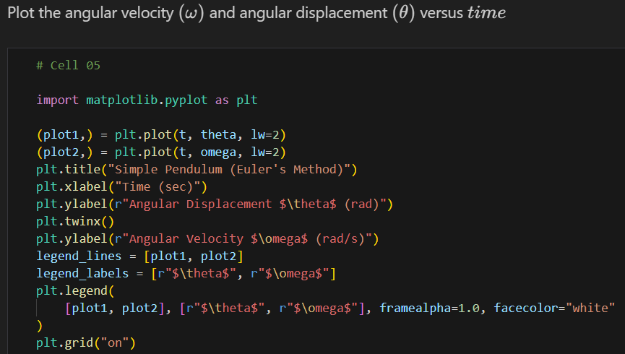
View euler_pendulum.ipynb – Cell 05
①
matplotlib supports rendering two different y-axes simultaneously in one figure
②
③
④
⑤
⑥

Slide 27
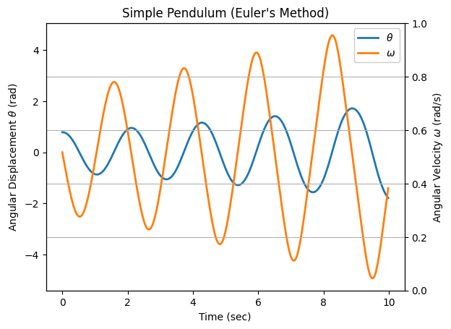

Run euler_pendulum.ipynb – Cell 05
Initial pendulum angular displacement from centerline
$$θ_{0}=0.78 rad$$
This is not good… The model predicts the pendulum will begin to swing wildly, which would not happen naturally!

Slide 28


Numerical Instability of Euler's Method For Oscillatory Modes
kinetic
potential
Increasing the number of time steps by 10x does not prevent the displacement from growing after each oscillation
The simple forward Euler method can be unstable for harmonic motion
The energy in the system is artificially growing over time without bounds because no term can be negative
$$E=\frac{1}{2}ml^{2}ω^{2}+mgl(1−\cos{θ})$$
$$\left(θ<{22}^{°},\cos{θ}≈1−\frac{θ^{2}}{2}\right)$$
Small angle identity
$$E=\frac{1}{2}ml^{2}\left(ω^{2}+\frac{g}{l}θ^{2}\right)$$
$$E_{i+1}=E_{i}+\frac{1}{2}ml^{2}\left(ω_{i}^{2}+\frac{g}{l}θ_{i}^{2}\right)Δt$$
Due to the squaring of values,
the next energy state will always be incorrectly higher than the previous energy state

Slide 29



Cromer's Fix to Euler's Method

Slide 30



Run cromer_pendulum.ipynb – Cells 01..04
We must use the next value for $ω$, not the current value of $ω$
①
Euler’s Method
②

Slide 31

Run cromer_pendulum.ipynb – Cell 05
This simulation is now numerically stable
What is the physics story at these circled times?

Slide 32
Runge-Kutta Methods
Around 1900, two German mathematicians, Carl Runge and Wilhelm Kutta, wanted to improve the accuracy of Euler's Method
Following the same motivation underlying Simpson's Rule for numerical integration, they developed a method of interpolating a curve between the endpoints of a sampled interval
Using a weighted combination of multiple tangent lines sampled throughout an interval, a more accurate derivative can be calculated than using the single tangent line in Euler's Method

Slide 33






Runge-Kutta Methods
Each $k_{n}$ is the value of the derivative at that point
$$h=Δx$$

Slide 34

Nonlinear Ordinary Differential Equation
Nowadays, High School Math Students are Doing Differential Equations

Slide 35











Nonlinear Ordinary Differential Equation
$$\frac{dy}{dx}=y∙\cos{x} y\left(0\right)=1$$
$$\ln{y}=\sin{x}+c$$
$$y=ce^{\sin{x}}$$
$$\left(\frac{1}{y}\right)\frac{dy}{dx}=\cos{x}$$
Initial Value
$$y\left(0\right)=1→c=1$$
$$\int{\frac{1}{y}ⅆy}=\int{\left(\cos{x}\right)ⅆx}$$
Solution:
$$y=e^{\sin{x}}$$
Check
$$\ln{y}+c=\sin{x}+c$$
$$\frac{d}{dx}\left(e^{\sin{x}}\right)=\frac{d}{du}\left(e^{u}\right)\frac{du}{dx} ,u=\sin{x}$$
$${=e}^{\sin{x}}\left(\frac{d}{dx}\left(\sin{x}\right)\right)$$
$$=e^{\sin{x}}∙\cos{x}$$

Slide 36




Open nonlinear_ode.py
①
$$\frac{dy}{dx}=y∙\cos{x}$$
②
③
④
⑤
⑥
$y_{1}→$ Euler’s Method
⑦
$y_{2}→$ Runge-Kutta Method
⑧

Slide 37


View nonlinear_ode.py
①
②
③
④
⑤
\mathcal{} = Calligraphic-style uppercase letters
⑥
⑦

Slide 38

Run nonlinear_ode.py
Euler's Method continues to lose accuracy each iteration

Slide 39
Run nonlinear_ode.py
RK4 is stable and more accurate than Euler’s Method

Slide 40

Runge-Kutta Methods

Slide 41



Hidden Figures, Fox 2000 Pictures, 2016
Runge-Kutta Method

Slide 42
Topic 04 – Goals - Part 2 of 3
Estimate numerical solutions to ordinary differential equations (ODEs) using SciPy
Model the harmonic motion of a simple pendulum using SciPy
Model a damped oscillator to appreciate the impact of critical damping
Analyze the long-term behavior of a harmonograph
Model the Newtonian Kinematics of an Estes Model Rocket through lift-off, where the system mass decreases as solid motor fuel is burnt to produce thrust

Slide 43
Solve ODEs with SciPy
We often must numerically solve systems of differential equations so we can simulate dynamic models
The Python package SciPy contains several ready-to-use numerical methods to estimate the solution to a variety of differential equations
Ordinary and Partial Differential Equations (ODE/PDE)
Linear and Non-Linear Differential Equations
Initial Value Problem (IVP) and Boundary Value Problems (BVP)
Both Individual and Systems of Linked Differential Equations

Slide 44

Scientific Computing with Python
https://scipy.org

Slide 45


Scientific Computing with Python

Slide 46

Modelling a Simple Pendulum
Gravity is a restoring force
$$F_{θ}=−mg\sin{θ}$$
$$l$$
$l=$ length
of the rod (constant)
$$ml\frac{d^{2}θ}{dt^{2}}=−mg\sin{θ}$$
$s=$ arclength along the perimeter
$\frac{g}{l}=$ Phase Constant
$$\frac{d^{2}θ}{dt^{2}}=−\frac{g}{l}\sin{θ}$$
$s=0$ when $θ=0$
$$s=lθ$$
$$F=ma$$
$$\frac{dω}{dt}=−\frac{g}{l}\sin{θ}$$
Take 2nd derivative of both sides with respect to time
We can break the 2nd order ODE into two linked first-order ODEs and use Euler’s method on each
$$F=m\frac{d^{2}s}{dt^{2}}$$
$$\frac{dθ}{dt}=ω$$
$$\frac{d^{2}s}{dt^{2}}=l\frac{d^{2}θ}{dt^{2}}$$
$$F_{θ}=ml\frac{d^{2}θ}{dt^{2}}$$

Slide 47






Open scipy_pendulum.py
$$\frac{d^{2}θ}{dt^{2}}=−\frac{g}{l}\sin{θ}$$
①
VSCode dims the brightness of variables you don’t use
②
③
④
⑤
⑥
$$\frac{dω}{dt}=−\frac{g}{l}\sin{θ}$$
Our 2nd order ODE does not contain a
$t$ (time) term on RHS
$\frac{g}{l}=$ Phase Constant
$$\frac{dθ}{dt}=ω$$
We return derivative values in the same order they are unpacked from the state_vector

Slide 48

View scipy_pendulum.py
①
②
Released from rest
③
④
⑤
⑥
⑦
⑧
⑨
Trailing comma makes it a tuple versus a scalar in parenthesis
⑩

Slide 49

View scipy_pendulum.py
①
②
③
④
⑤
⑥
The plt.twinx() function in Matplotlib creates a secondary y-axis that shares the same x-axis with the primary y-axis. This allows you to plot two datasets on the same plot with two different y-axes

Slide 50

Run scipy_pendulum.py

Slide 51
Damped Harmonic Oscillator
In real-world oscillators, friction (or damping) slows the system’s motion. Due to the frictional force, the velocity decreases in proportion to the acting frictional force
In contrast to a simple undriven harmonic oscillator (where the only force acting on the mass is the restoring force), in a damped harmonic oscillator, there is an additional frictional force that always acts in the direction opposing the motion
Our goal is to create mathematical models that mirror reality as closely as possible. Friction, a ubiquitous force in the real world, is a crucial element that should never be overlooked in any rigorous simulation

Slide 52


Damped Harmonic Oscillator
$$\frac{d^{2}θ}{dt^{2}}=−\frac{g}{l}\sin{θ}$$
$\frac{g}{l}=$ The phase constant
We can introduce a new resistive force term into the equation of motion for a pendulum
$$\frac{d^{2}θ}{dt^{2}}=−q\frac{dθ}{dt}−\frac{g}{l}\sin{θ}$$
$q$= The damping constant
Due to the frictional force, the velocity decreases in proportion to the acting frictional force
$$\frac{dω}{dt}=−qω−\frac{g}{l}\sin{θ}$$
$$\frac{dθ}{dt}=ω$$

Slide 53


Damped Harmonic Oscillator
Underdamped – The system swings back and forth (oscillates) over its equilibrium point, but ultimately comes to rest
Example: $q=1$
Overdamped – The system never oscillates, but it takes a while for it to return to its equilibrium point
$$\text{Example}\text{:} q=\frac{{\left(phase constant\right)}^{2}}{2}$$
Critically damped – The system never oscillates and returns to its equilibrium point in the least amount of time
$$q=\frac{{\left(phase constant\right)}^{2}}{4}$$
Note: There is only one value for $q$ where the system is critically damped

Slide 54



Open damped_pendulum.py
①
②
③
④
⑤
③
④

Slide 55

View damped_pendulum.py
①
②
③
④
⑤

Slide 56



View damped_pendulum.py
①
②
③
④
⑤
⑥
⑦

Slide 57


View damped_pendulum.py
$$\frac{d^{2}θ}{dt^{2}}=−q\frac{dθ}{dt}−\frac{g}{l}\sin{θ}$$
①
②
③
④
⑤

Slide 58

Run damped_pendulum.py
In what applications would you want a system to be critically damped?

Slide 59

Damped Harmonic Oscillator

Slide 60


Tuned Mass Dampers
Taipei 101 – Taiwan
The Worlds Tallest Building (2004-2009)
730 Tons

Slide 61

Tuned Mass Dampers
365 Minivans

Slide 62

Coupled Harmonograph

Slide 63


Coupled Harmonograph
Each pendulum controls the X or Y displacement

Slide 64



Open harmonograph.py
①
②
③
④
⑤
⑥
⑦
⑧
⑨

Slide 65

View harmonograph.py
①
The adaptive step size control used in methods like 'RK45' dynamically adjusts the step size to maintain the error within specified tolerances, especially
in regions where the solution changes rapidly
②
③
④
⑤

Slide 66


View harmonograph.py
①
We plot the dependent variable values (theta) of both curves
against each other
We don’t include the
independent variable time
This visualizes the “tug of war” between the two pendulums pulling on the shared pen drawing the curve

Slide 67


Run harmonograph.py
$$l_{1}≠l_{2}$$
$$θ_{1i}=θ_{2i}$$
$$ω_{1i}=ω_{2i}$$

Slide 68


Lissajous Figures

Slide 69

Lissajous Orbits

Slide 70

Lissajous Orbits
Lagrange Point
Lagrange Point

Slide 71

Lissajous Orbits
A Halo Orbit

Slide 72



Slide 73

Estes Model Rocket
This Estes Model Rocket has two stages, with each stage containing its own Estes F15 rocket motor
After the 1st (booster) stage is ignited, the rocket will blast off and begin to rise using just the booster motor
After the 1st stage motor burns out, the booster stage (with its spent motor) is ejected, the 2nd stage F15 motor ignites, and the rocket continues to ascend
The 2nd stage and its motor remain part of the rocket throughout the duration of the flight
Stage 2
Stage 1

Slide 74
Estes Model Rocket
The Stage 1 booster has a mass of 0.0519 kg (not including its F15 motor)
The Stage 2 main rocket has a mass of 0.1729 kg (not including its F15 motor)
An Estes F15 rocket motor has a mass of 0.101 kg, generates a thrust of 17.2 Newtons, and burns for 1.6 seconds
For this simulation, we will assume the thrust of a motor is constant throughout its burn, assume there is no delay between the ejection of the booster and the ignition of the Stage 2 motor, and ignore air friction
Stage 2
Stage 1

Slide 75







Estes Model Rocket
We must model the trajectory of the rocket over the first four seconds of its flight: from liftoff to booster separation and into its unpowered glide phase
We want to calculate the rocket’s expected velocity (mph) and altitude (feet) over time (seconds) and determine its average speed and maximum height through four seconds
We will assume the mass of each motor reduces linearly throughout its burn (100% of mass at ignition and 0% of mass at moment of burnout)
The force of gravity resisting the rocket is:
$$F_{g}=\frac{G×M_{E}×m}{{\left(R+h\right)}^{2}}$$
$$G=Gravitatinal Constant$$
$$m=Mass of rocket$$
$$M_{E}=Mass of Earth$$
$$h=Height of rocket$$
$$R=Radius of Earth$$

Slide 76

Open estes_rocket.py
①
②
③

Slide 77

View estes_rocket.py
①
Once the elapsed time since liftoff exceeds the burn time of both motors, there is no longer any thrust
②
③
④
⑤
⑥
⑦
⑧
⑨
2nd Stage Motor has no mass from unburnt fuel

Slide 78



View estes_rocket.py
①
②
v = velocity
h = height (alt)
③
④
⑤
⑥
$$F=ma$$
⑦
$$s=vt$$
⑧

Slide 79
View estes_rocket.py
①
②
③
④
⑤

Slide 80

View estes_rocket.py
①
②
③
④
⑤

Slide 81

Run estes_rocket.py
Linear?
③
Non-linear
②
Non-linear
①
Why is the slope greater in Phase 2 of the flight versus Phase 1?
Because of the non-linear jumps in thrust/impulse, no analytic solution exists

Slide 82
Topics 04 – Goals – Part 3 of 3
Solve coupled non-linear ODEs to model predator-prey dynamics
Visualize the S-I-R compartment model used in epidemiology to model the spread over time of infectious disease across a population
Model the electrostatic field around the charged parallel plates inside a capacitor where the surrounding walls are conductors (fixed potential) or insulators (fixed charge)
Numerically estimate solutions to the Laplace 2nd order partial differential equation using both Neumann and Dirichlet boundary conditions
Use a convolution kernel (a stencil) to perform Jacobi relaxation over a discretized grid

Slide 83



Predator-Prey Modelling
https://en.wikipedia.org/wiki/Lotka-Volterra Equations
1925
Visualize the Lotka-Volterra differential equations
with these characteristics & initial conditions:
$$α=2, β=1.1, γ=1.0, δ=0.9$$
$$x\left(0\right)=1, y\left(0\right)=0.5$$
In this model, at any time$t$ :
$x\left(t\right)$ represents the prey population
$y\left(t\right)$ represents predator population
Alfred Lotka
$α=$ Prey Birth Rate
$β=$ Prey Death Rate
$γ=$ Pred Death Rate
$δ=$ Pred Birth Rate
The solution to their system of coupled non-linear 1st order differential equations can be numerically estimated using the scicpy solve_ivp function
Vito Volterra

Slide 84


Run predator_prey.ipynb – Cell 01
①
$α=2.0$ Prey Birth Rate
$β=1.1$ Prey Death Rate
$γ=1.0$ Pred Birth Rate
$δ=0.9$ Pred Death Rate
②
③
④
\u = Unicode symbol’s codepoint in hexadecimal
⑤
⑥

Slide 85

Run predator_prey.ipynb – Cell 02
①
The model signature must include a time parameter, even if it is not used
②
③
④
In Python, functions are objects too!
⑤
⑥
⑦

Slide 86




Run predator_prey.ipynb – Cell 03
①
Once created, tuples are immutable
②
③
④
⑤
Recall SciPy’s RKF45 solver is an adaptive algorithm – the width of each time interval $\left(dt\right)$ may be different across the domain
⑥
⑦
⑧

Slide 87

View predator_prey.ipynb – Cell 04
①
②
③
④

Slide 88

Locators in matplotlib

Slide 89

Run predator_prey.ipynb – Cell 04
These don’t seem wave-like
What story is this graph telling?

Slide 90


Epidemiological Modeling
Based upon the pioneering work of Hudson and Ross, the Kermack-McKendrick (1933) S-I-R equations model the spread of infectious diseases throughout a population
$S(t)$ = Susceptible population
$I(t)$ = Infected population
$R(t)$ = Recovered population
$β=$ Infection rate factor
$δ=$ Recovery rate factor
Hilda Hudson
As time progresses, the population changes from one compartment to the next: $S→I→R$
Note: the total population in this model does not change
$$\frac{ⅆS}{ⅆt}=−βSI$$
$$\frac{ⅆI}{ⅆt}=βSI−δI$$
$$\frac{ⅆR}{ⅆt}=δI$$
Ronald Ross
We seek the functions $S\left(t\right), I\left(t\right),and R(t)$

Slide 91


Epidemiological Modeling
$β=$ Infection rate factor
$δ=$ Recovery rate factor
As people become infected, the susceptible population decreases
As more people are infected, the faster the disease is spread to the susceptible
$$\frac{ⅆS}{ⅆt}=−βSI$$
William Kermack
Having more susceptible people makes it easier for the infection to find a new host
Susceptible people become infected (𝜷) and infected people become recovered ($δ$)
$$\frac{ⅆI}{ⅆt}=βSI−δI$$
The number of recovered people increases over time
$$\frac{ⅆR}{ⅆt}=δI$$
Anderson McKendrick

Slide 92






Open epidemiology.py
$β=$ Infection rate factor
$δ=$ Recovery rate factor
$$\frac{ⅆS}{ⅆt}=−βSI$$
$$\frac{ⅆI}{ⅆt}=βSI−δI$$
$$\frac{ⅆR}{ⅆt}=δI$$
r does not appear in the RHS of any differential
①
②
③
④
⑤
⑥

Slide 93



View epidemiology.py
①
②
④
Recovery Rate $≫$ Infection Rate
③
④
⑤
Only $1$ person is sick at the start
⑥
⑦

Slide 94

View epidemiology.py
①
②
③

Slide 95

Run epidemiology.py
What story is this graph telling?

Slide 96

S-I-R Model Epidemiology
The infected population will fall more slowly than it rises, hence it takes much longer to rid a population of an infection than it takes for the initial infection to spread
A percentage of people will remain susceptible for a very long time - hence the need for an ongoing vaccination program – think about smallpox, polio, etc.
I first made these slides in 2016 – before COVID-19 ☹
Mathematics doesn’t care about your politics

Slide 97


Slide 98

Electrostatic Field in Parallel Plates

Slide 99

Electrostatic Field in Parallel Plates

Slide 100


Electrostatic Fields
$$Coulomb^{′}s Law$$
$$F∝\frac{q_{1}q_{2}}{r^{2}}⟹F=k\frac{q_{1}q_{2}}{r^{2}}$$
$$k=\frac{1}{4πε_{0}} (Coulomb^{′}s constant)$$
$$F=\frac{q_{1}q_{2}}{4πε_{0}r^{2}}$$
$q=$ Electric charge
$ℰ_{0}=$Permittivity of free space
Electric Potential (Voltage)
$$E=\frac{q_{1}q_{2}}{4πε_{0}}\left[\frac{1}{r_{A}}−\frac{1}{r_{B}}\right]$$
$$W_{A→B}=\int_{A}^{B}{Fⅆs}$$
q2
B
A
A as reference point $∴$ $r_{B}=∞$
$$E\left(r\right)=\frac{q_{1}q_{2}}{4πε_{0}}\int_{A}^{B}{\frac{1}{r^{2}}ⅆr}$$
q1
$$E_{A}=\frac{q_{1}q_{2}}{4πε_{0}r_{A}}$$
$$\int{\frac{1}{r^{2}}=−\frac{1}{r}}$$
$$\frac{−1}{r_{B}}−\frac{−1}{r_{A}}=\frac{1}{r_{A}}−\frac{1}{r_{B}}$$

Slide 101

Electric Field Potential Between Charges
Electric Potential (V)
A scalar field
Electric Field (V/m)
A vector field
?

Slide 102







Electrostatic Field in Parallel Plates
$∇ ≡$ gradient (del) operator (nabla)
$ρ=$ charge density
$ϵ_{0}=$ electric field permittivity
Gauss's Law for Electric Fields – Electric fields diverge from positive charges and converge on negative charges
$∇∘\vec{E}=\frac{ρ}{ϵ_{0}}$
$\vec{E}$ is the electric field
(a vector field)
$$\vec{E}=−∇V$$
$V$ is the electric potential (voltage) (a scalar field)
The negative sign indicates that the electric field points towards a decreasing potential
Physically, this means that a positive charge will naturally move from regions of higher potential to regions of lower potential
$∇\vec{E}=0$ for an electrostatic field (the $\vec{E}$field isn’t changing)
$$∇\vec{E}=0→∇\left(−∇V\right)=0→∇^{2}V=0$$
Multiply both sides by -1

Slide 103










Electrostatic Field in Parallel Plates
$$∇^{2}V=0$$
For a function to be static, it is not enough for the first derivative to be zero – think of the pendulum at the far left or right of its swing…
Its 2nd derivative must also be zero!
$$∇^{2}V=\frac{∂^{2}V}{∂x^{2}}+\frac{∂^{2}V}{∂y^{2}}=0$$
2D Continuous
Discretization
over a 2D Grid
$$V_{i,j}→\frac{1}{4}\left(V_{i+1,j}+V_{i−1,j}+V_{i,j+1}+V_{i,j−1}\right)=0$$
$$i−1$$
$$i$$
$$i+1$$
$$j−1$$
+
$$\left(i,j\right)=(x,y)$$
$$j$$
+
c
+
$$j+1$$
+

Slide 104




Electrostatic Field in Parallel Plates
$$∇^{2}V=0$$
For a function to be static, it is not enough for the first derivative to be zero – think of the pendulum at the far left or right of its swing…
Its 2nd derivative must also be zero!
$$∇^{2}V=\frac{∂^{2}V}{∂x^{2}}+\frac{∂^{2}V}{∂y^{2}}=0$$
2D Continuous
Discretization
over a 2D Grid
$$V_{i,j}→\frac{1}{4}\left(V_{i+1,j}+V_{i−1,j}+V_{i,j+1}+V_{i,j−1}\right)=0$$
A convolution kernel (a stencil)
$$\left[\begin{matrix}0 & 1/4 & 0 \\ 1/4 & 0 & 1/4 \\ 0 & 1/4 & 0\end{matrix}\right]$$

Slide 105
Electrostatic Field in Parallel Plates
If we apply the convolution of the kernel to successive overlapping 3 x 3 swatches of the field grid (across both the x and y dimensions), we will find the “next in time” value of the electric field for each point in the grid
A convolution involves multiplying each cell in the 3 x 3 kernel with the corresponding cell in the current swatch location (within the grid) and then summing those nine products
We convolve the entire 2D field grid with the kernel enough times to ensure every “next in time” grid cell value is equal to its “prior in time” grid cell value – meaning there is no change over time
When this condition is realized, we have reached a steady state and therefore have an electrostatic field. This iterative approach is called the Jacobi Relaxation Method

Slide 106
Electrostatic Field in Parallel Plates
With ordinary differential equations (ODEs), we must specify the initial conditions for an exact solution. We must specify boundary conditions with partial differential equations (PDEs)
In our simulation of the electrostatic field around parallel plates, we have two choices for boundary conditions:
Neumann boundary conditions: the plates are surrounded by walls of conductors, thus preventing any electric potential from building up along the walls. The cells around the outermost edges of the grid are forced to maintain the same field strength as their neighboring cells. This makes a zero gradient along the walls
Dirichlet boundary conditions: the plates are surrounded by walls of insulators, thus preventing any electric charge from building up along the walls, so the cells around the outermost edges of the grid are forced to maintain zero voltage

Slide 107



Open parallel_plates.py
①
②
③
Top wall
Top wall
Bottom wall
Bottom wall
Left wall
Left wall
Right wall
Right wall
Zero change at the walls
Zero value at the walls

Slide 108

View parallel_plates.py
①
②
③

Slide 109




View parallel_plates.py
①
②
Left plate at -1 Volts
Right plate at +1 Volts
③
Discretize over a $\left(100×100\right)$ grid
④
Each plate is 40 rows tall by
1 column wide, separated by 40 columns
$$\left[\begin{matrix}0 & 1/4 & 0 \\ 1/4 & 1/4 & 1/4 \\ 0 & 1/4 & 0\end{matrix}\right]$$
⑤
Boolean indexing
2=2D, 1=one grid step away from center
$$\left[\begin{matrix}0 & 1/4 & 0 \\ 1/4 & 0 & 1/4 \\ 0 & 1/4 & 0\end{matrix}\right]$$
⑥

Slide 110

View parallel_plates.py
①
Max iterations to achieve stasis
②
③
④
⑤
⑥
Output size: The constant mode ensures the output grid is the same as the input grid
Zero-padding: The input grid is extended with zeros beyond its boundaries before the convolution operation. This padding ensures that the kernel can overlap with all elements of the input grid, even those near the edges
Convolution operation: The kernel slides over the extended input grid, computing the dot product at each input grid position

Slide 111

View parallel_plates.py
①
②
③
A function name has an intrinsic value
④
⑤
We are modeling a square grid

Slide 112

Run parallel_plates.py

Slide 113


Edit parallel_plates.py
Edit line 36
to set the right plate to +9V

Slide 114

Run parallel_plates.py

Slide 115

Edit parallel_plates.py
Edit lines 35 & 36
to set the left & right plates to -9V

Slide 116

Run parallel_plates.py

Slide 117

Topic 04 – Now You Know…
Euler’s Method (forward-in-time step analysis) yields numeric solutions to differential equations
We can model 2nd order differentials by representing them as a chain of linked 1st order equations
Euler-Cromer is better when modelling harmonic oscillators
A higher-order approach like Runge-Kutta improves accuracy
Increasing the number of time steps (decreasing $∆t)$ improves the accuracy of the estimations, but then requires more time to run

Slide 118
Topic 04 – Now You Know…
The scipy package has many numerical solvers for systems of differential equations
Even a simple set of linked differential equations can yield highly complex long-term behavior of systems
Most dynamical systems have critical values that are related to its fundamental equilibrium points (consider the damping constant)
We can estimate solutions to systems of linked non-linear ODEs using the Runge-Kutta Method
The S-I-R epidemiology models have been greatly enhanced by modern research in computational biology
The language of all science is Differential Equations – please try to learn about them!

Slide 119

Task 04-01
Edit harmonograph.py to reproduce this ellipse:

Slide 120


Task 04-02
Create a Jupyter Lab notebook file called rlc_circuit.ipynb
Your code should plot the current over time flowing through an RLC circuit that maintains a constant DC voltage
Use SciPy to estimate this 2nd order homogenous ODE out to 1 second in duration using these values
$$\frac{d^{2}}{{dt}^{2}}I\left(t\right)=−\frac{R}{L}\frac{d}{dt}I\left(t\right)−\frac{1}{LC}I(t)$$
R = 0.1 Ohms
L = 0.01 Henries
C = 0.01 Farads
Initial I = 1 Amp

Slide 121

Task 04-02 (hint)

